Slide 1

Wrapper Classes

Slide 2
Agenda
After this session, you will learn about:
Wrappers
Creating Wrapper Objects
Built-in Wrapper Conversion Utilities

Slide 3
Wrapper Classes
Wrappers
Java provides type wrappers, which are classes that encapsulate a primitive type within an object.
The type wrappers are Double, Float, Long, Integer, Short, Byte, Character, and Boolean.
These classes offer a wide array of methods that allow you to fully integrate the primitive types into Java’s object hierarchy.

Slide 4
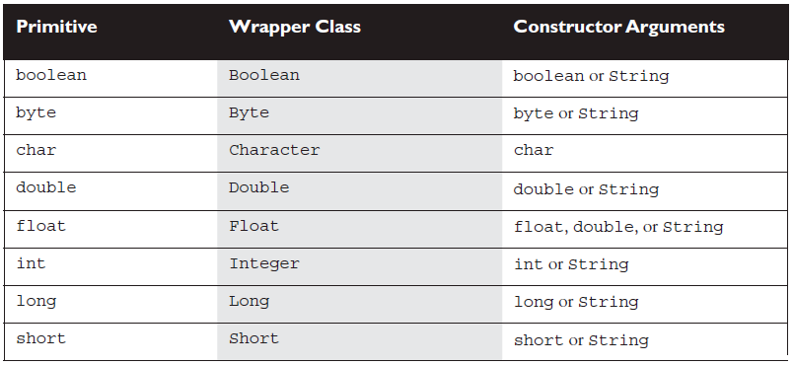
Using Wrapper Classes and Boxing

Slide 5
Wrapper Classes
Creating Wrapper Objects
package com.imarticus.tutorial.arraystringcollectiongenerics.demos.WrapperClasses;
public class BookDetails {
public static void main(String args[]) {
Integer oldBookId = new Integer(21);
Integer newBookId = new Integer("42");
Float oldPrice = new Float(4.15f);
Float newPrice = new Float("3.14f");
Character author = new Character('K');
//The constructors for the Boolean wrapper take either a boolean value true or false, or a String.
Notes:
C:\Users\vivinaya\Desktop\Muthu\course-content-preparation\semester2\1-java8\2-arrays-strings-collections-generics\2-class-exercises-and-demos\arrays-strings-collections-generics\src\com\imarticus\tutorial\arraystringcollectiongenerics\demos\WrapperClasses\BookDetails.java

Slide 6
Wrapper Classes
Using Wrapper Conversion Utilities
//The valueOf() Methods
Integer bookToken = Integer.valueOf("101011", 2);
Float tokenPrice = Float.valueOf("3.14f");
//The xxxValue() Methods
Integer noOfbooks = new Integer(42); // make a new wrapper object
Notes:
C:\Users\vivinaya\Desktop\Muthu\course-content-preparation\semester2\1-java8\2-arrays-strings-collections-generics\2-class-exercises-and-demos\arrays-strings-collections-generics\src\com\imarticus\tutorial\arraystringcollectiongenerics\demos\WrapperClasses\BookDetails.java

Slide 7
Wrapper Classes
Using Wrapper Conversion Utilities
System.out.println("The Old ID is "+ oldBookId );
System.out.println("The New ID is "+ newBookId );
System.out.println("The Old Price is "+ oldPrice );
System.out.println("The New Price is "+ newPrice );
System.out.println("The Author name starts with "+ author );
System.out.println("Current booktoken is "+ bookToken );
System.out.println("The token price is "+ tokenPrice );
System.out.println("No of books available today "+ noOfbooks );
}
}
Notes:
C:\Users\vivinaya\Desktop\Muthu\course-content-preparation\semester2\1-java8\2-arrays-strings-collections-generics\2-class-exercises-and-demos\arrays-strings-collections-generics\src\com\imarticus\tutorial\arraystringcollectiongenerics\demos\WrapperClasses\BookDetails.java

Slide 8
Wrapper Classes
Using Wrapper Conversion Utilities
The toString() Methods
Since we know that all other Java classes inherit from class Object, we also know that all other Java classeshave a toString() method.
Double price = new Double("3.14");
System.out.println(“book price = "+ price.toString() ); // result is book price = 3.14
All of the numeric wrapper classes provide an overloaded, static toString() method that takes a primitive numeric of the appropriate type (Double.toString() takes a double, Long.toString() takes a long, and so on) and, of course, returns a String:
String book price = Double.toString(3.14); // book price = "3.14“

Slide 9
Wrapper Classes
Using Wrapper Conversion Utilities
The toXxxString() (Binary, Hexadecimal, Octal) Methods
The Integer and Long wrapper classes let you convert numbers in base 10 to other bases.
These conversion methods, toXxxString(), take an int or long, and return a String representation of the converted number, for example:
String hex_value= Integer.toHexString(254); // convert 254 to hex
System.out.println("254 is " + hex_value); // result: "254 is fe“
String octal = Long.toOctalString(254); // convert 254 to octal
System.out.print("254(oct) ="+ octal); // result: "254(oct) =376"

Slide 10

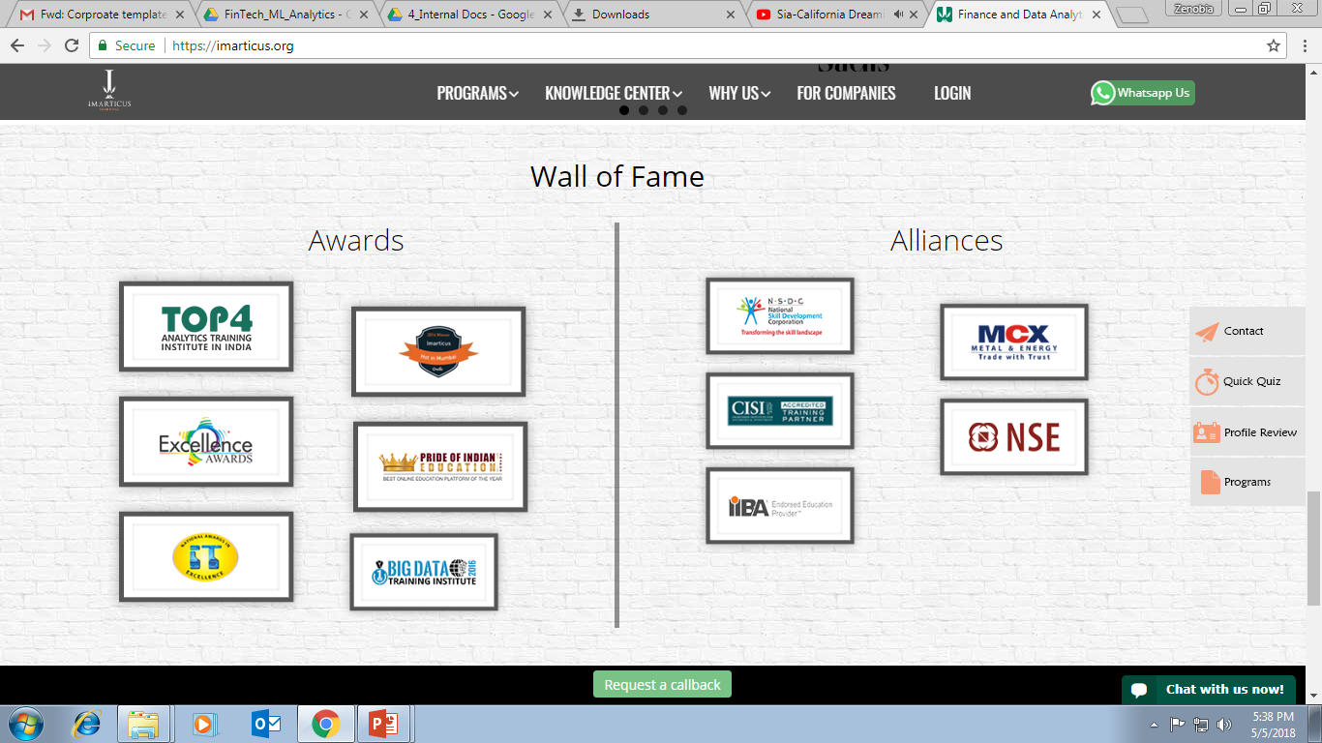



AWARDS:
Learn more:
https://imarticus.org/corporate/
Email us:
info@imarticus.com
Connect with us:
www.linkedin.com/company/imarticuslearning
ACCREDITED TRAINING PARTNER:
Watch us:
www.youtube.com/ImarticusLearninginstitute
Visit us:
Mumbai | Thane | Pune | Bangalore | Delhi - NCR | Hyderabad | Chennai | Coimbatore

